Slide 1

Designing custom inconsistent knowledge graphs
MSc Artificial Intelligence Master thesis
Thomas de Groot

Slide 2








Overview
Intro
Background
Approach
Method
Internal Validation
Application
External Validation
Conclusion

Slide 3


Introduction

Slide 4

Introduction

Slide 5




Research Questions
RQ1: Can we define a formal definition?
RQ2: How can we retrieve these patterns?
RQ3: Can we classify the patterns?
RQ4: Can we design methods using patterns?

Slide 6
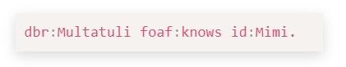
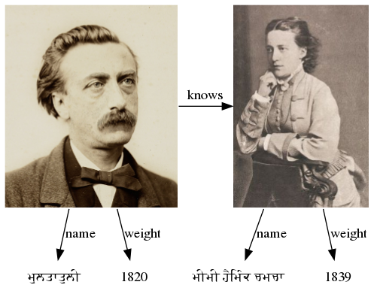
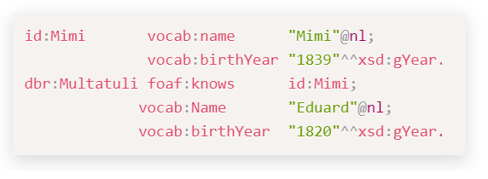
Background
Triple
Graph
Graphical Representation

Slide 7
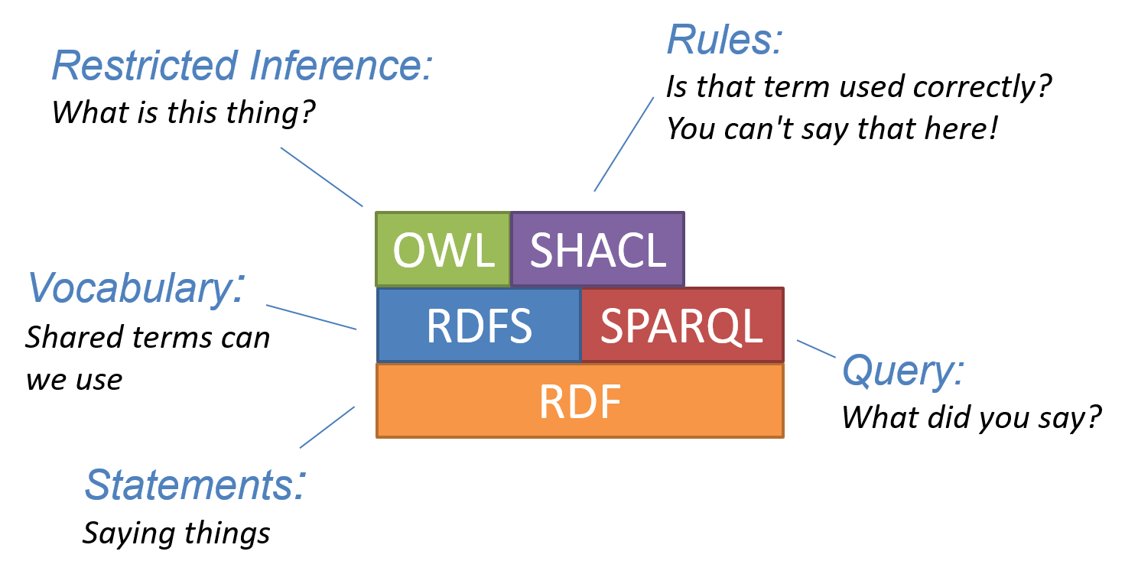
Background

Slide 8
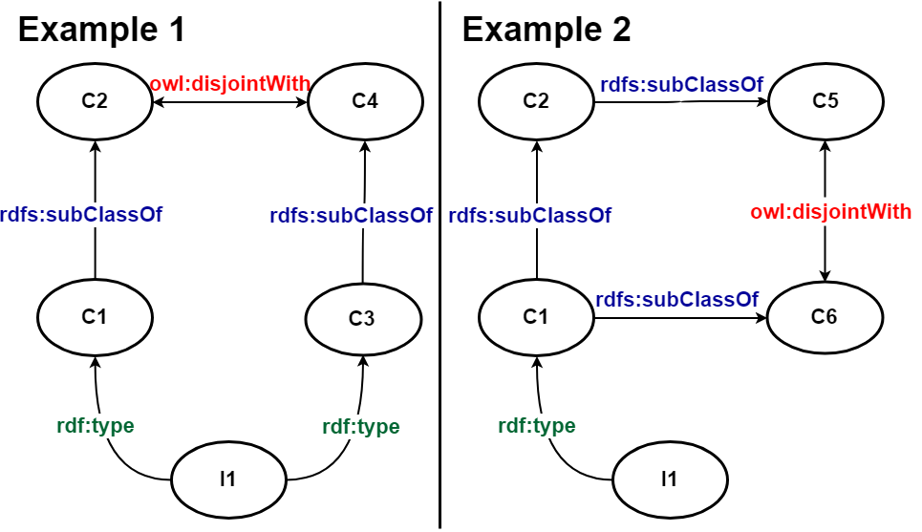
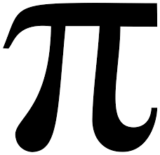

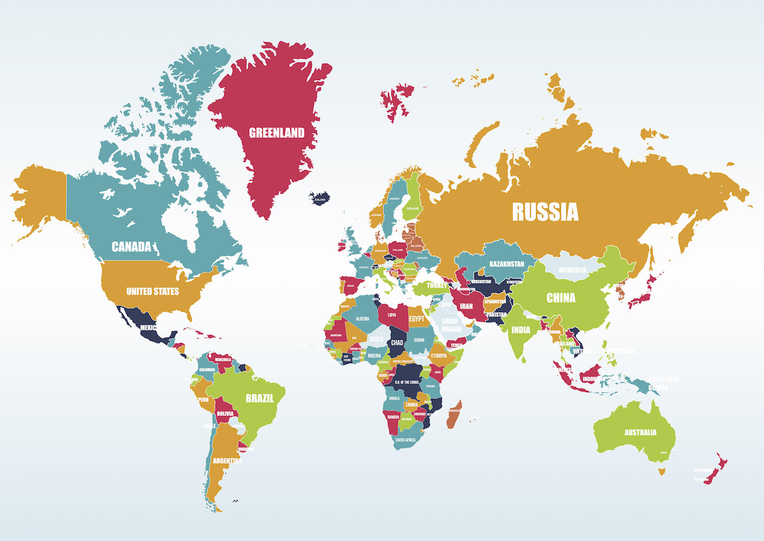
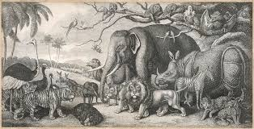

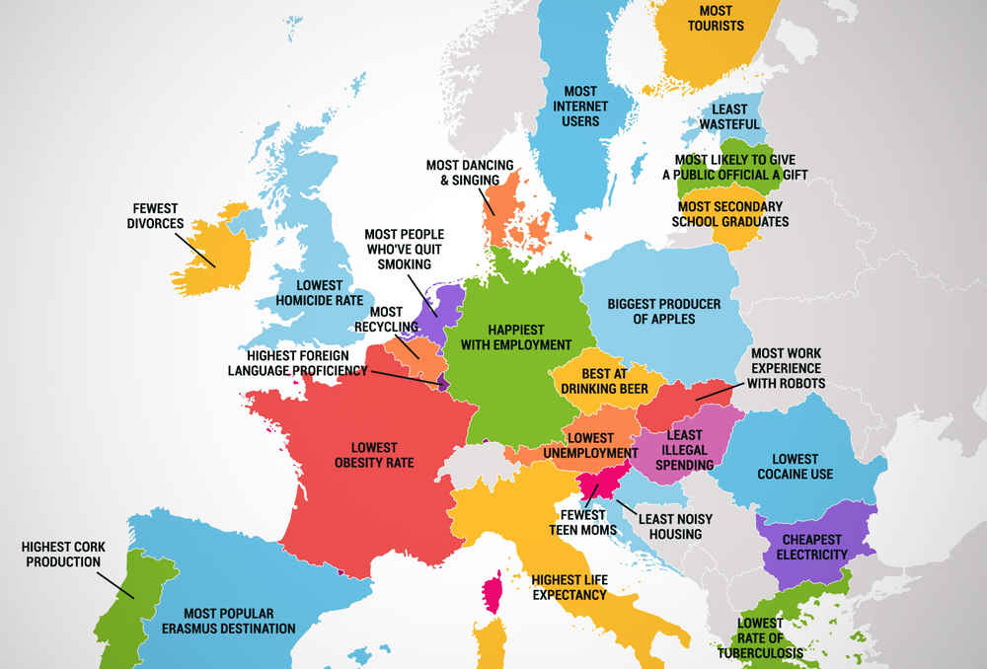


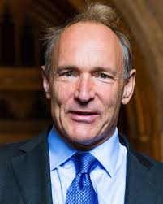
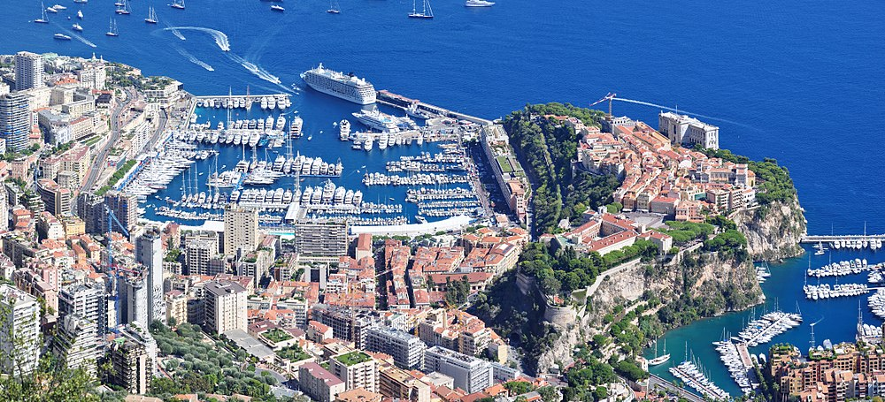
Background

Slide 9
Background

Slide 10
An `Anti-pattern' of a knowledge graph G is a minimal set of uninstantiated Basic Triple Patterns that match an inconsistent subgraph of G.
Formal definition of an Anti-pattern

Slide 11
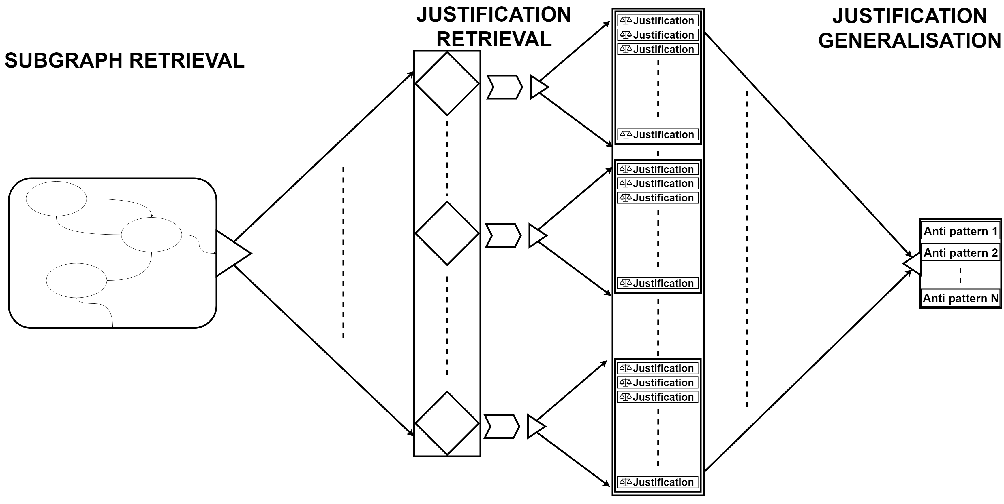
Approach

Slide 12
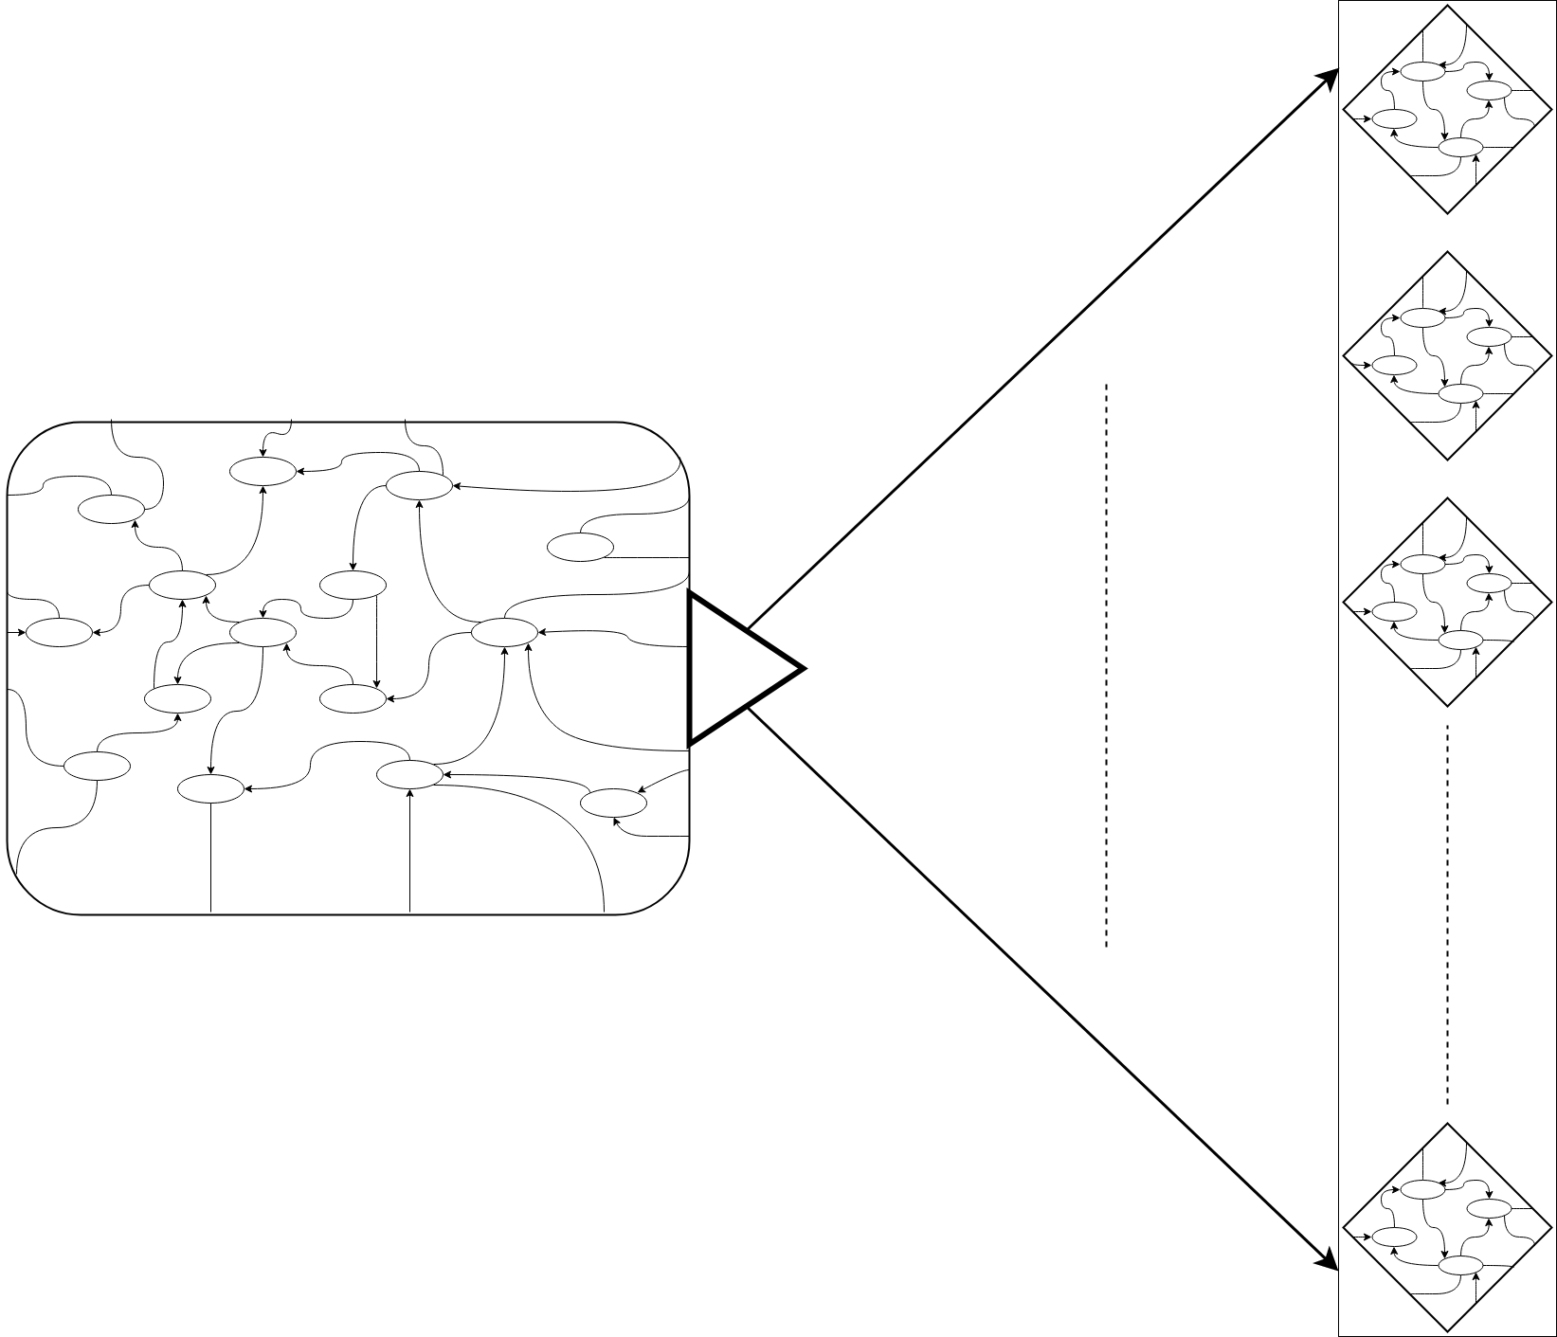
Method
Impractical to retrieve contradictions from the complete graph
Splitting the graph into smaller graphs most viable method
Possible to break existing contradictions
Implement redundancy to combat.

Slide 13
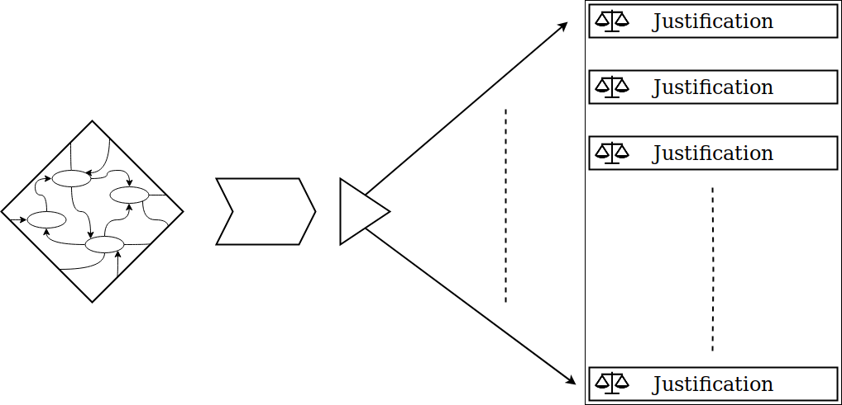
Method
Check if the subgraph is consistent
When the graph is inconsistent retrieve the reasons why.
Find the minimal justification for each contradiction.

Slide 14
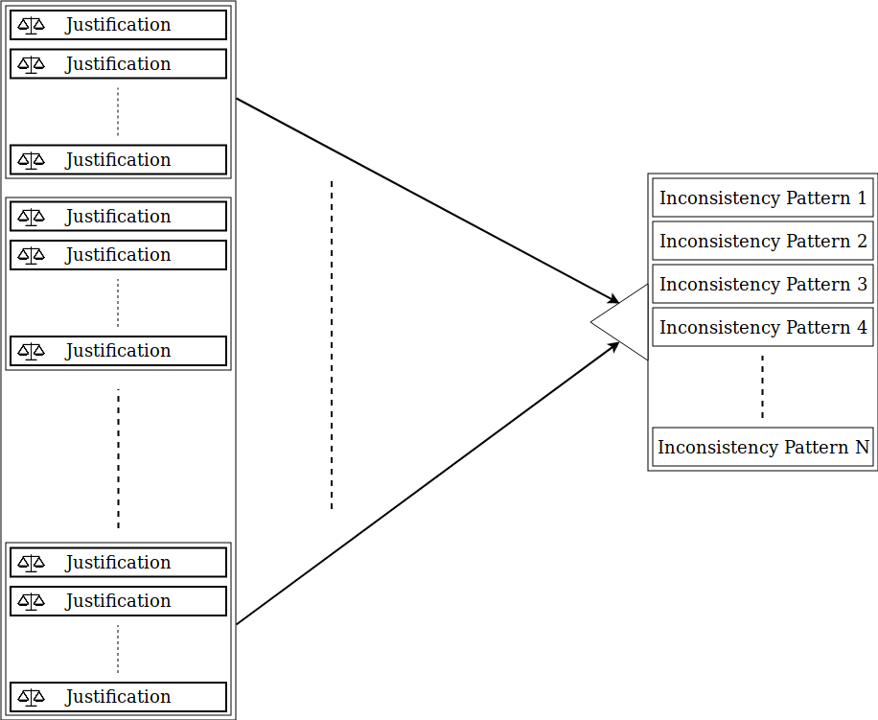
Method
Each justification is transformed in their Inconsistency pattern.
If the consistency pattern is not yet known it is added to the list of inconsistencies.

Slide 15
Datasets
Name | Size | Link
LOD-a-lot | 28,362,198,927 | http://lod-a-lot.lod.labs.vu.nl/
DBpedia | 1,040,358,853 | https://wiki.dbpedia.org/
YAGO | 158,991,568 | https://github.com/yago-naga/yago3
DBLP | 55,586,971 | https://dblp.uni-trier.de/
wordnet | 5,558,748 | https://wordnet.princeton.edu/
swdf | 242,256 | https://old.datahub.io/dataset/scholarlydata
Pizza | 1,944 | https://protege.stanford.edu/ontologies/pizza/pizza.owl

Slide 16
Data statistics
Name | Size | Namespaces | Amount of `Anti-patterns' | Largest Inconsistency
LOD-a-lod | 28,362,198,927 | >100 | 222 | 19
DBpedia | 1,040,358,853 | 20 | 13 | 12
YAGO | 158,991,568 | 11 | 135 | 16
DBLP | 55,586,971 | 7 | Not inconsistent | Not inconsistent
wordnet | 5,558,748 | 5 | Not inconsistent | Not inconsistent
swdf | 242,256 | 22 | Not inconsistent | Not inconsistent
Pizza | 1,944 | 6 | 2 | 5

Slide 17
Measuring completeness
 | Inconsistent | Found inconsistenties
2,000 triple subgraphs | Yes | 2
500 triple subgraphs | Yes | 2
100 triple subgraphs | Yes | 2
Pellet | Yes | 2
HermiT | Yes | 2

Slide 18



SPARQL validation
Application
Inconsistency Analytics
Inconsistent knowledge graph sampling

Slide 19
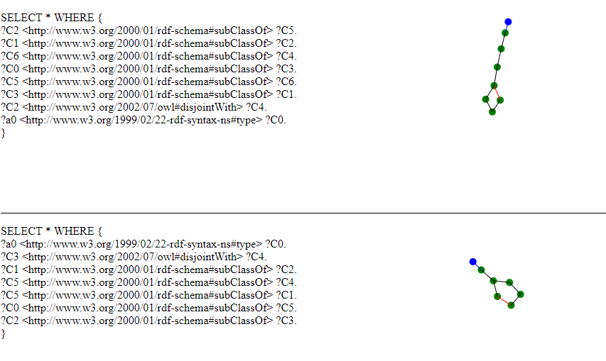
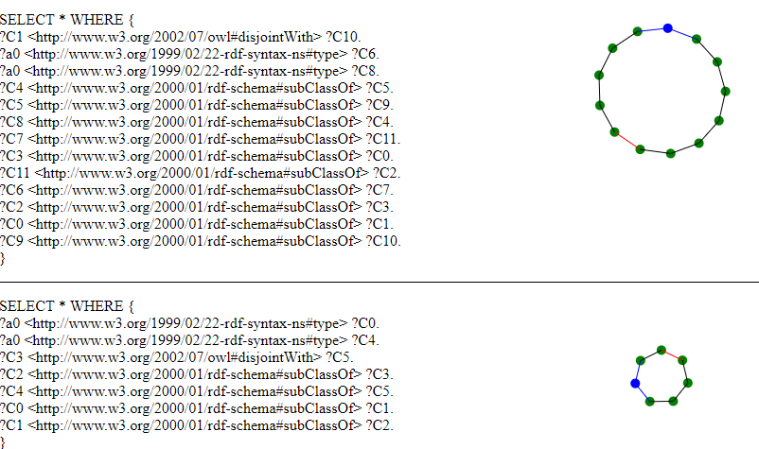
Application (SPARQL validation)

Slide 20
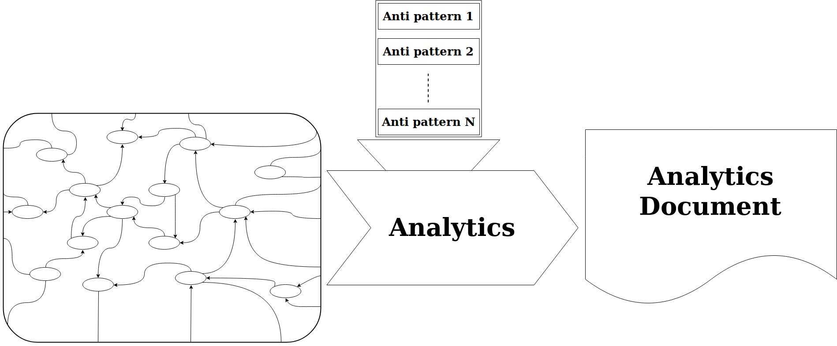
Application (Analytics)

Slide 21
Application (Analytics)
General statistics
The distribution of indegree over all the nodes.
The distribution of outdegree over all the nodes.
The distribution of the Clustering Coefficient
Inconsistency statistics
Amount of `anti-patterns' in the knowledge graph.
Largest `anti-patterns' by the number of basic triple patterns found in the knowledge graph.
Distribution of the occurrences of contradictions found in the knowledge graph.
Distribution of the sizes of `anti-patterns' found in the knowledge graph.

Slide 22
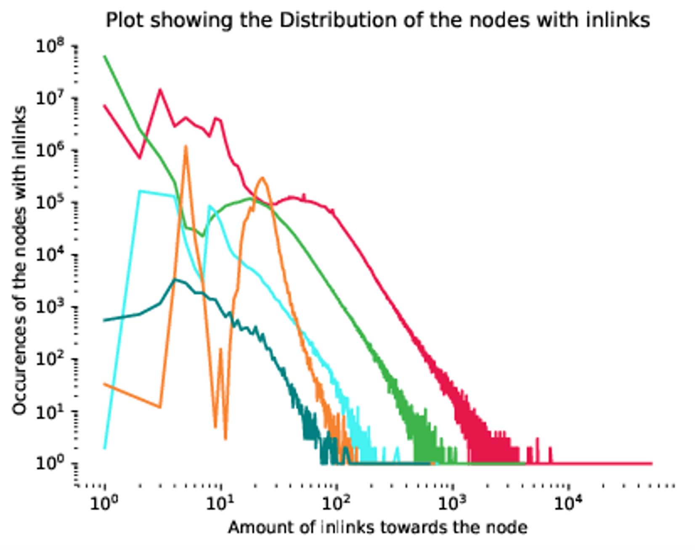
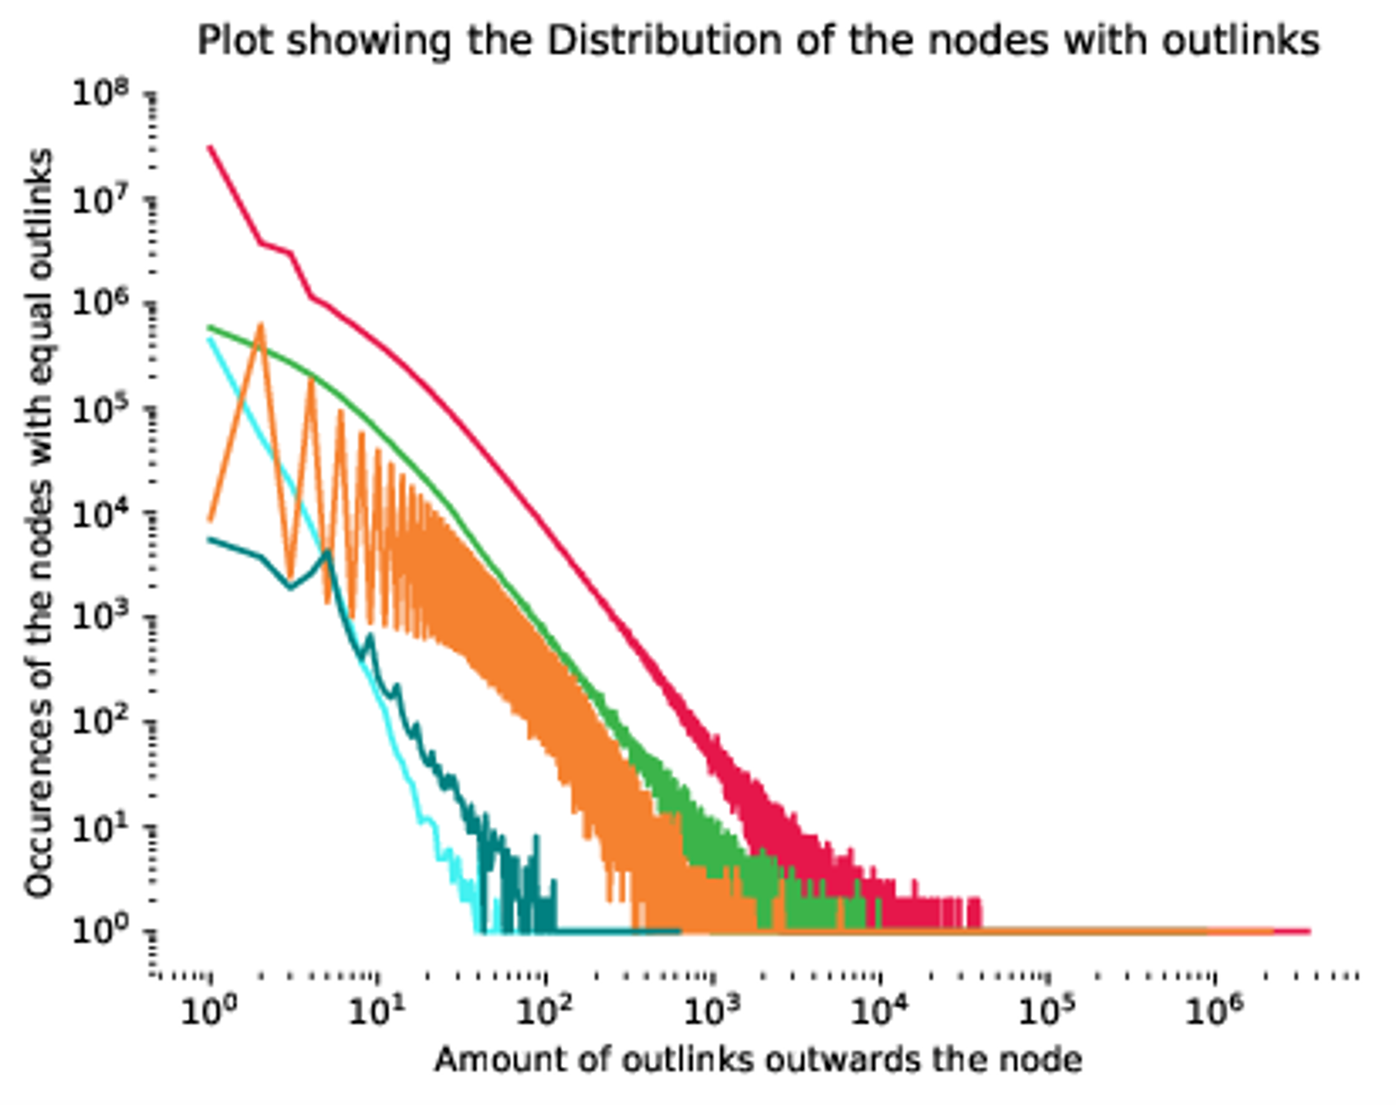
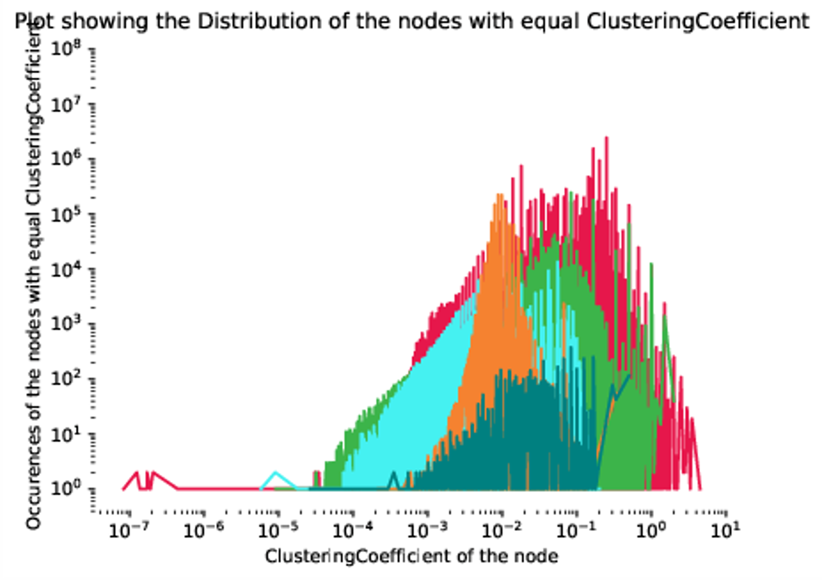
Knowledge graph wide statistics.
- Creates awareness about the graphs.
- Comparison for sampling
Application (Analytics)

Slide 23
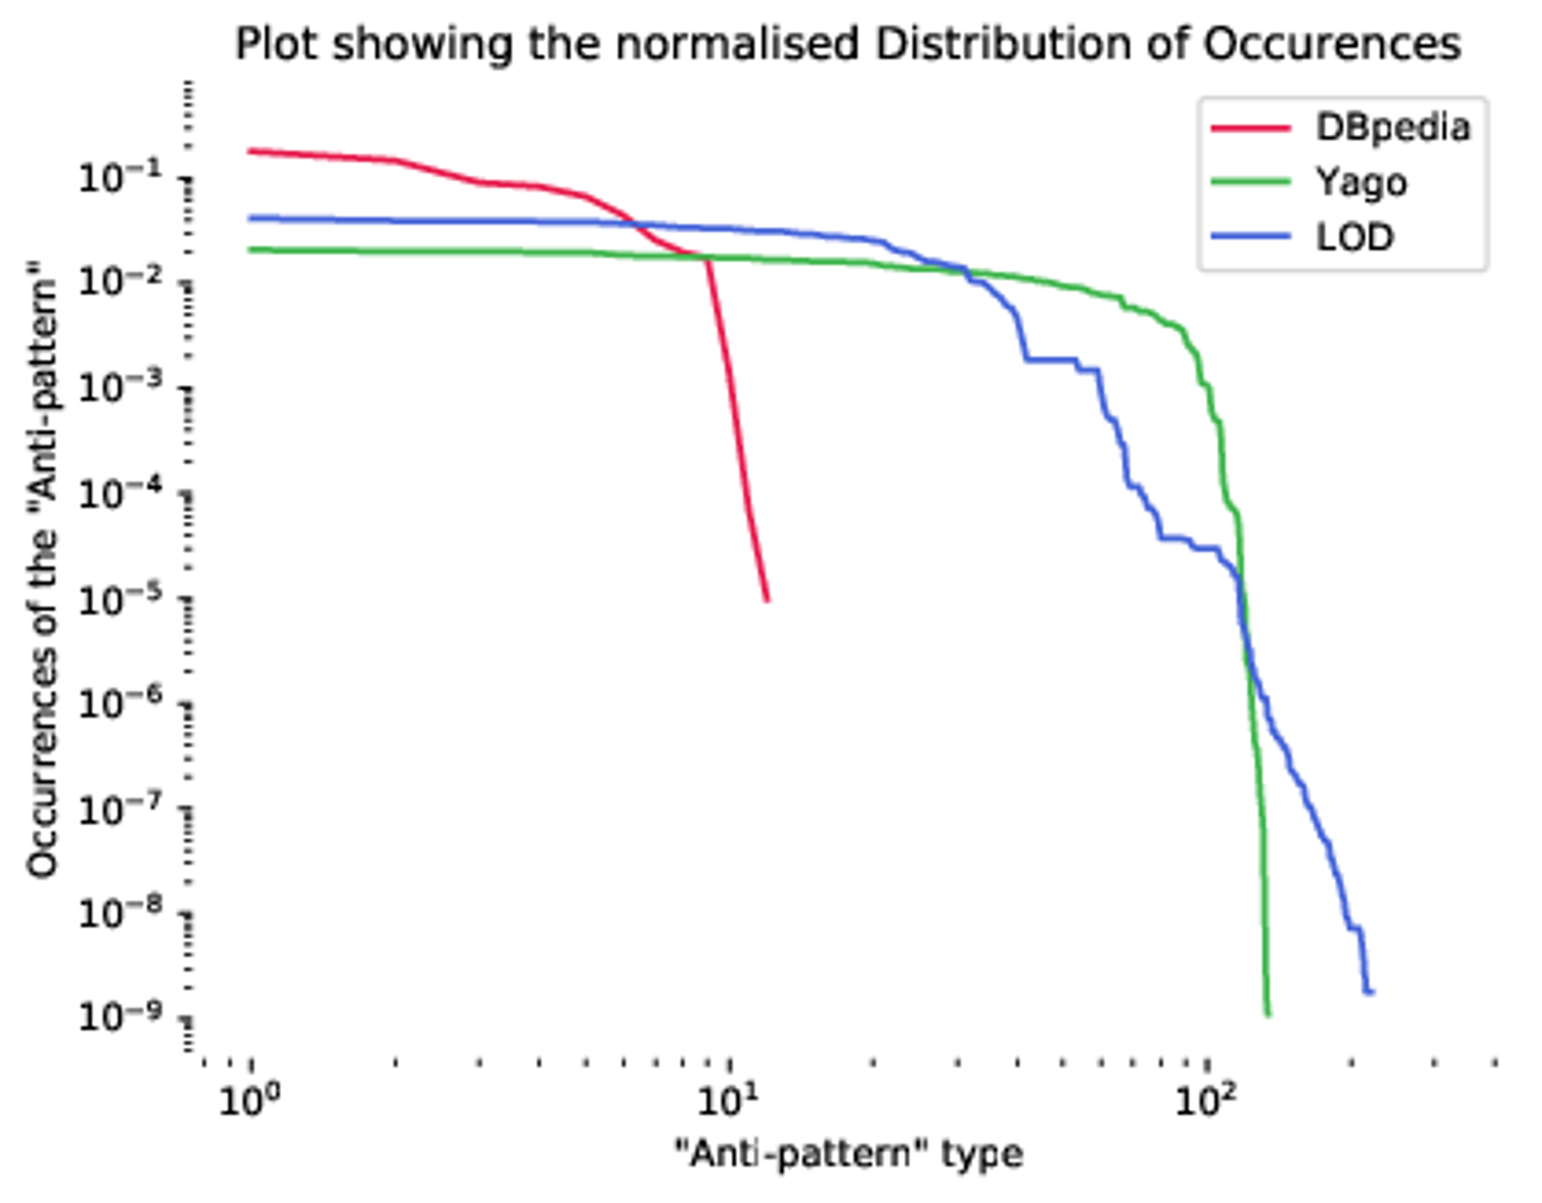
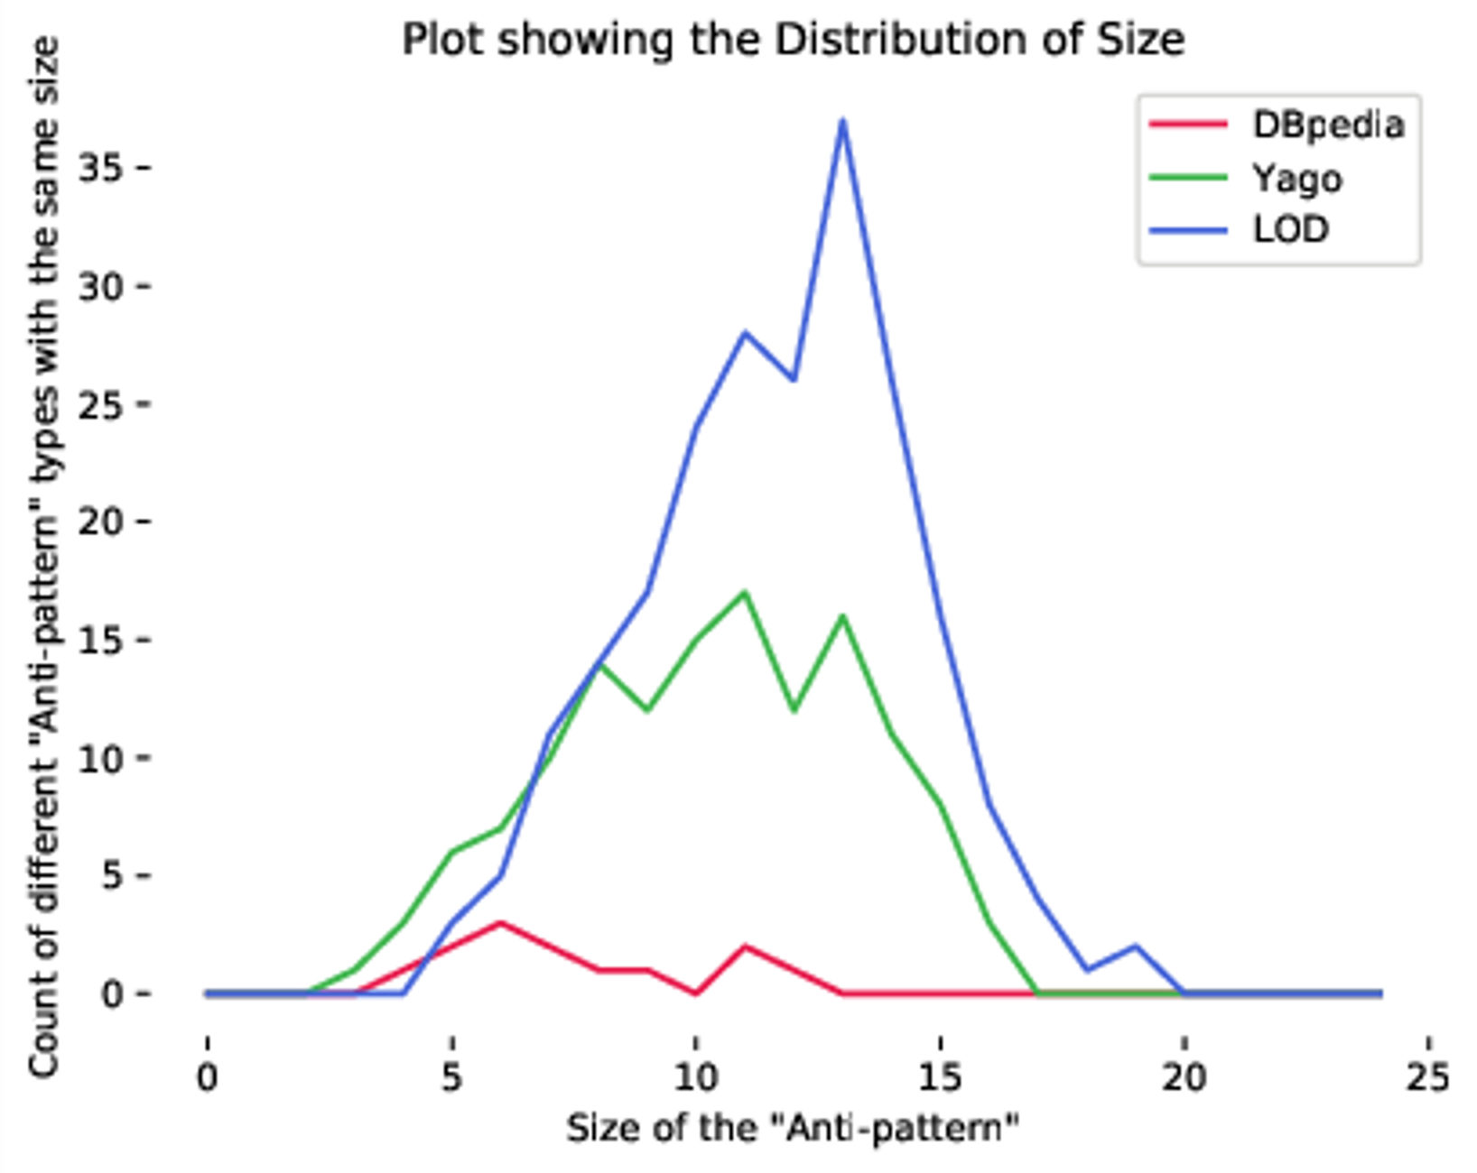
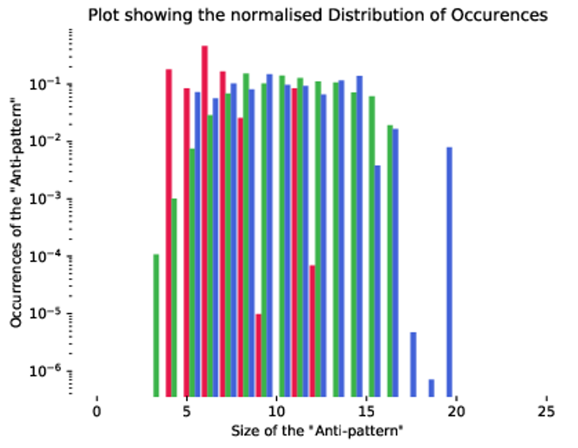
Knowledge graph statistics on `Anti-patterns’
- Using `anti-patterns’ for defining statistics
Application (Analytics)

Slide 24
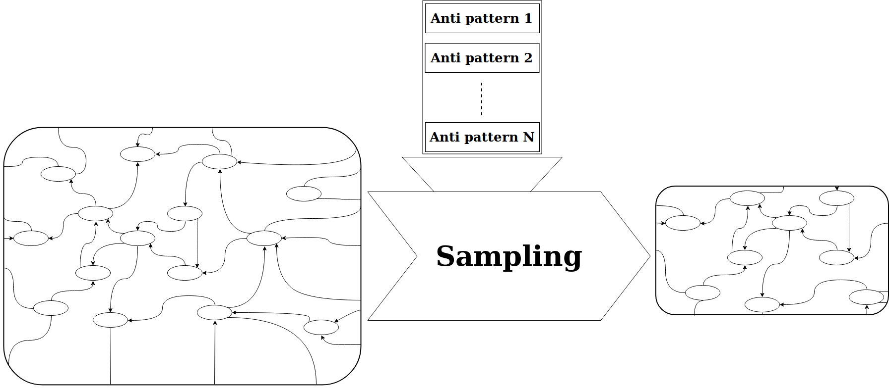
Application (Sampling)

Slide 25
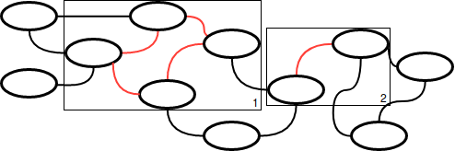
Application (Sampling)
Challenges
Keep the contradictions in sample
Not break graph into subgraphs
Retain original characteristics

Slide 26
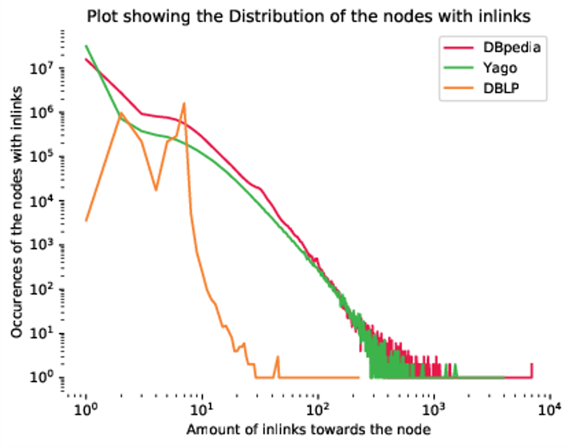
Distribution comparison of inlinks between the Samples of YAGO, Dbpedia and DBLP and their original graphs.
Comparison with the Sample

Slide 27
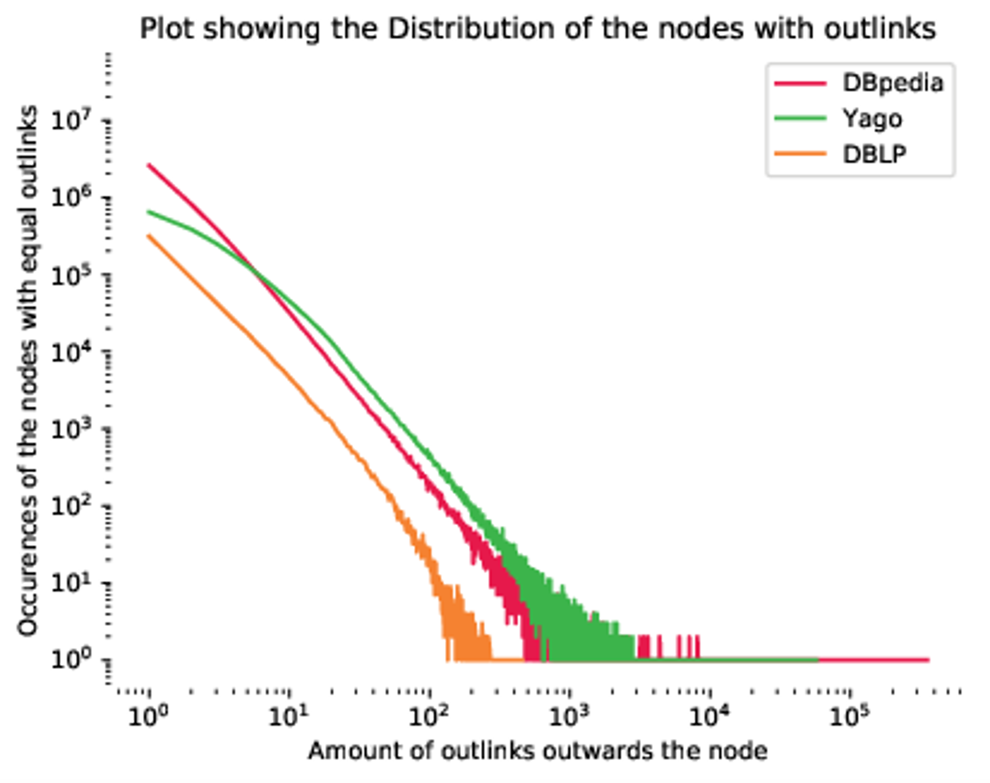
Distribution comparison of outlinks between the Samples of YAGO, Dbpedia and DBLP and their original graphs.
Comparison with the Sample

Slide 28
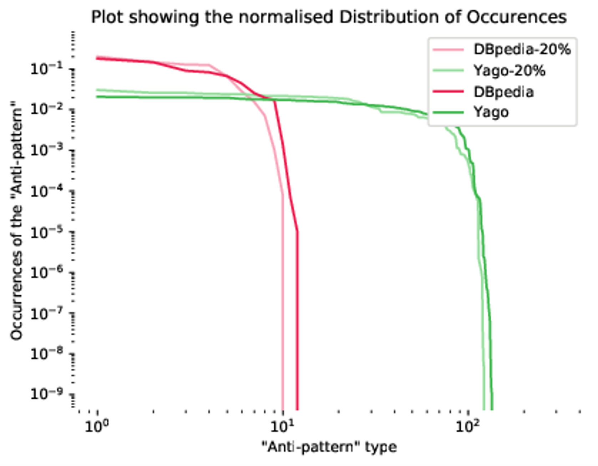
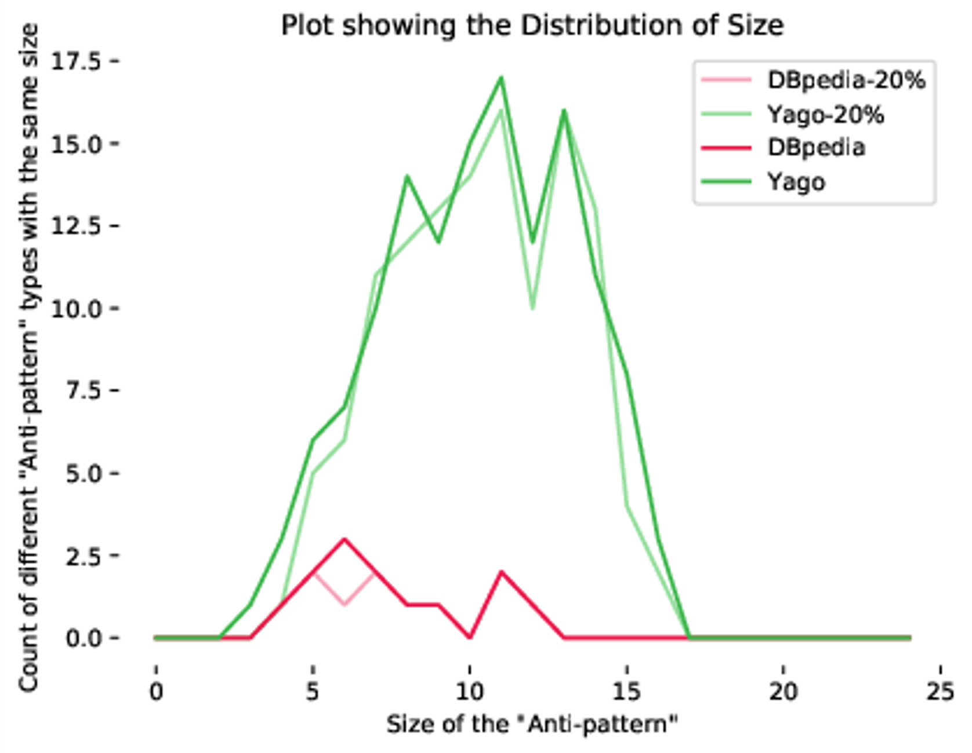
Comparison with the sample
Comparison:
- Distribution of `Anti-pattern’ occurrences. - Distribution of `Anti-pattern’ grouped by size.

Slide 29

Conclusion
Derived a formal definition of an `Anti-pattern’
Delivered an extraction pipeline.
Implemented two method using `Anti-patterns’
Analysis
Sampling

Slide 30

Future Work
Investigating lesser known knowledge graphs
Improved analysis on ‘Anti-patterns’

Slide 31

Thank you for your attention

